Slide 1

Amazon Sales Forecasting
Merged Analysis: Data Correlation + Regression Modeling
Capstone Project | April 2025

Slide 2
Project Objective
Predict product sales using historical data from Amazon platform.
Understand feature relationships through correlation analysis.
Compare and evaluate regression models using PyCaret.

Slide 3
Dataset Overview
Includes daily sales, ads, and session data over last 2 years.
Converted monthly and weekly data to daily format for better granularity.
Key fields: Units Ordered, Traffic, Page Views/Sessions, Ad Spend.

Slide 4
Data Cleaning & Preprocessing
Removed nulls and irrelevant columns.
Transformed time features (Month, Week, Year).
Converted categorical variables to numeric (if any).

Slide 5
Feature Engineering
Scaled features for regression modeling.
Using Chi Square, Feature Importance and Heat Map
Eliminated highly dependent columns (e.g., Units Ordered).

Slide 6
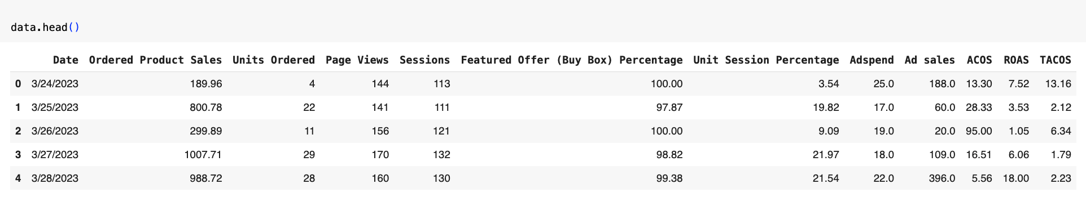

Slide 7
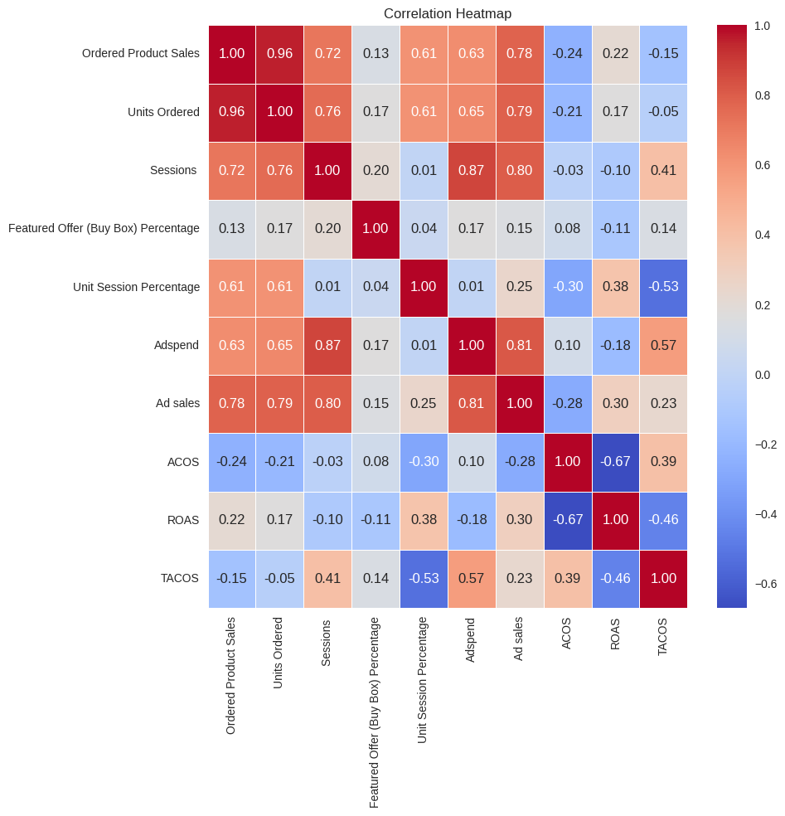

Slide 8
Modeling with PyCaret
Used PyCaret's regression module for fast model comparison.
Initialized setup by defining target variable (Sales).
Automatically handled encoding, scaling, and transformation.

Slide 9
Regression Models Evaluated
Tested models: LightGBM, XGBoost, Random Forest, Huber, Linear Regression.
Used default settings initially, then tuned best performers.
Compared using metrics: MAE, RMSE, R².

Slide 10
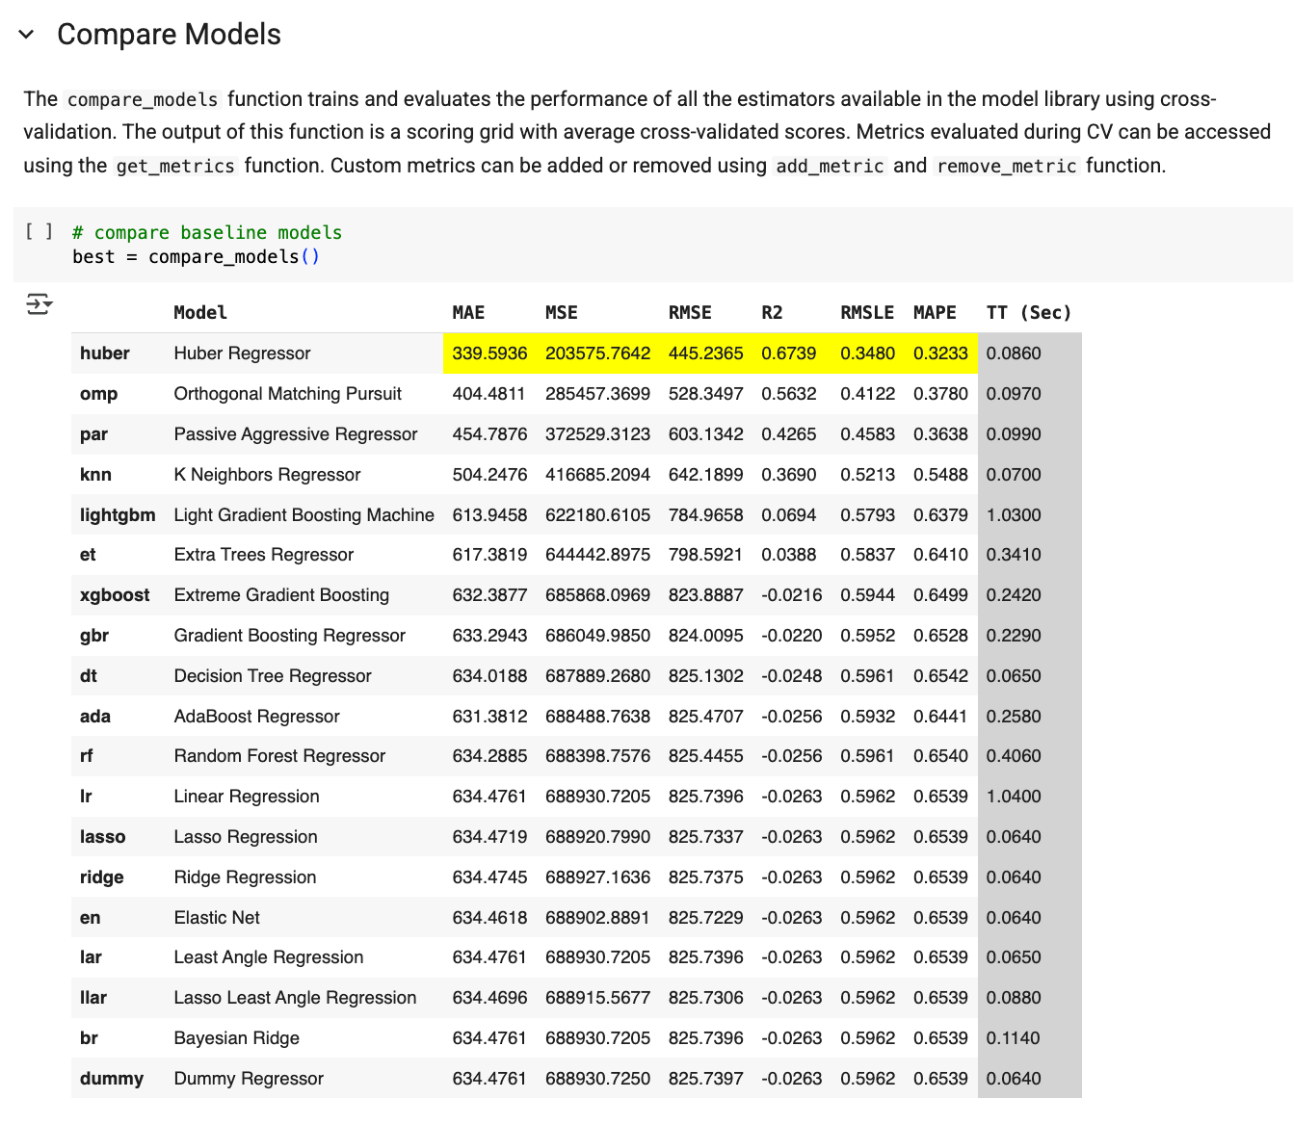
Modeling with PyCaret
.

Slide 11
Best Performing Model
Huber selected for best performance (low RMSE, high R²).
Handled non-linear relationships well and avoided overfitting.

Slide 12
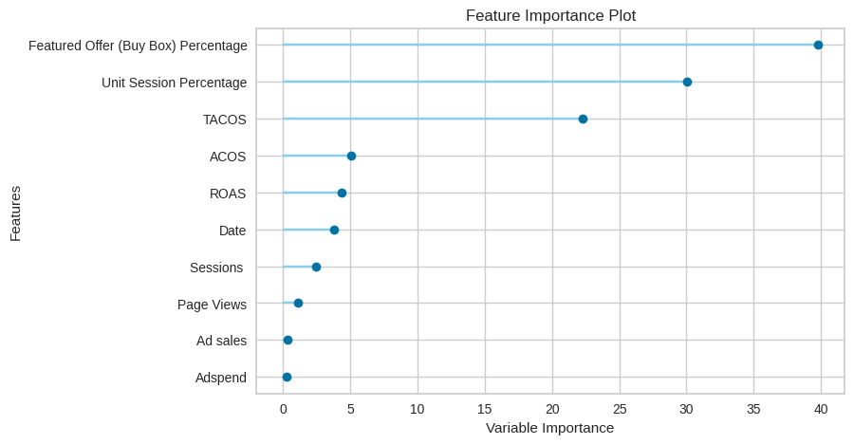
Feature importance

Slide 13
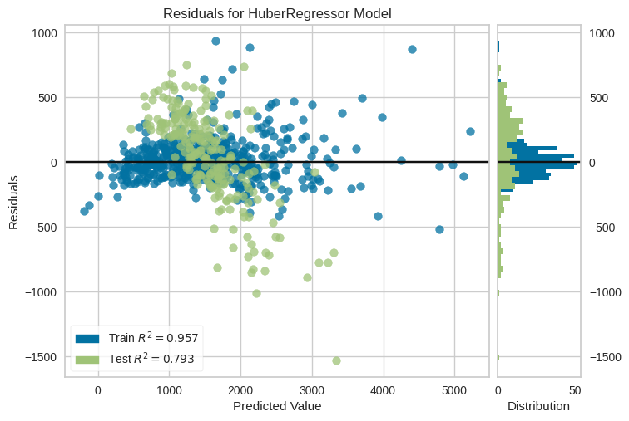
Residuals

Slide 14
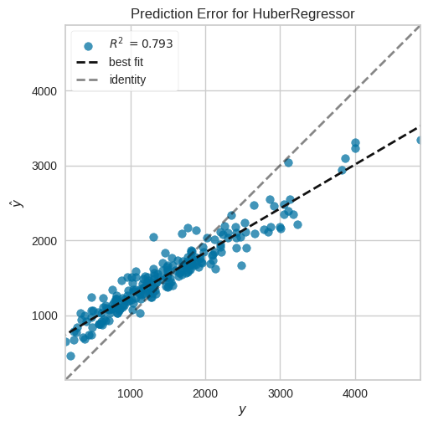
Prediction Error

Slide 15
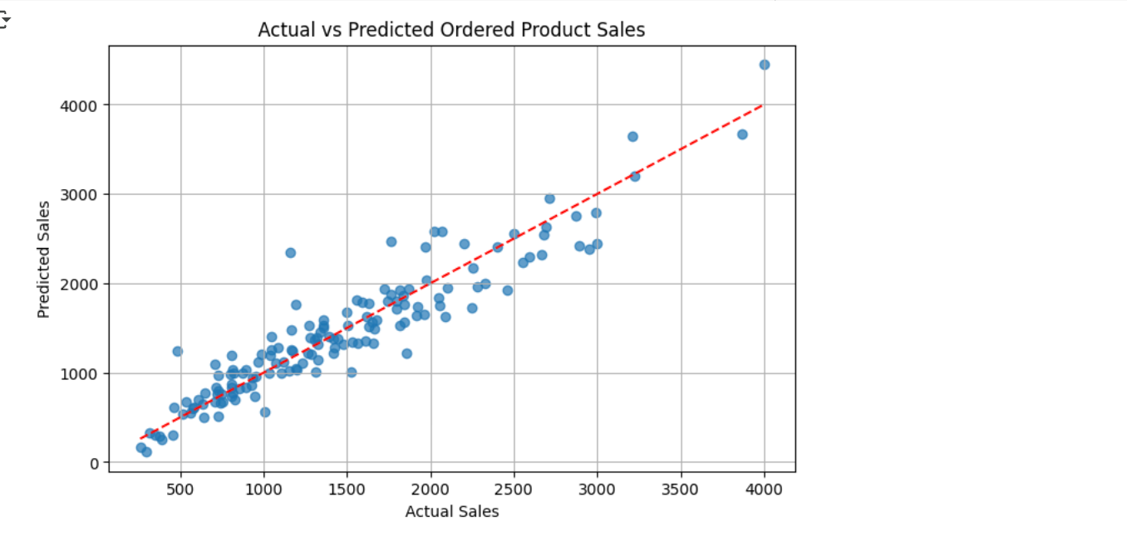
Actual vs Predicted Sales Using Amazon Dataset

Slide 16
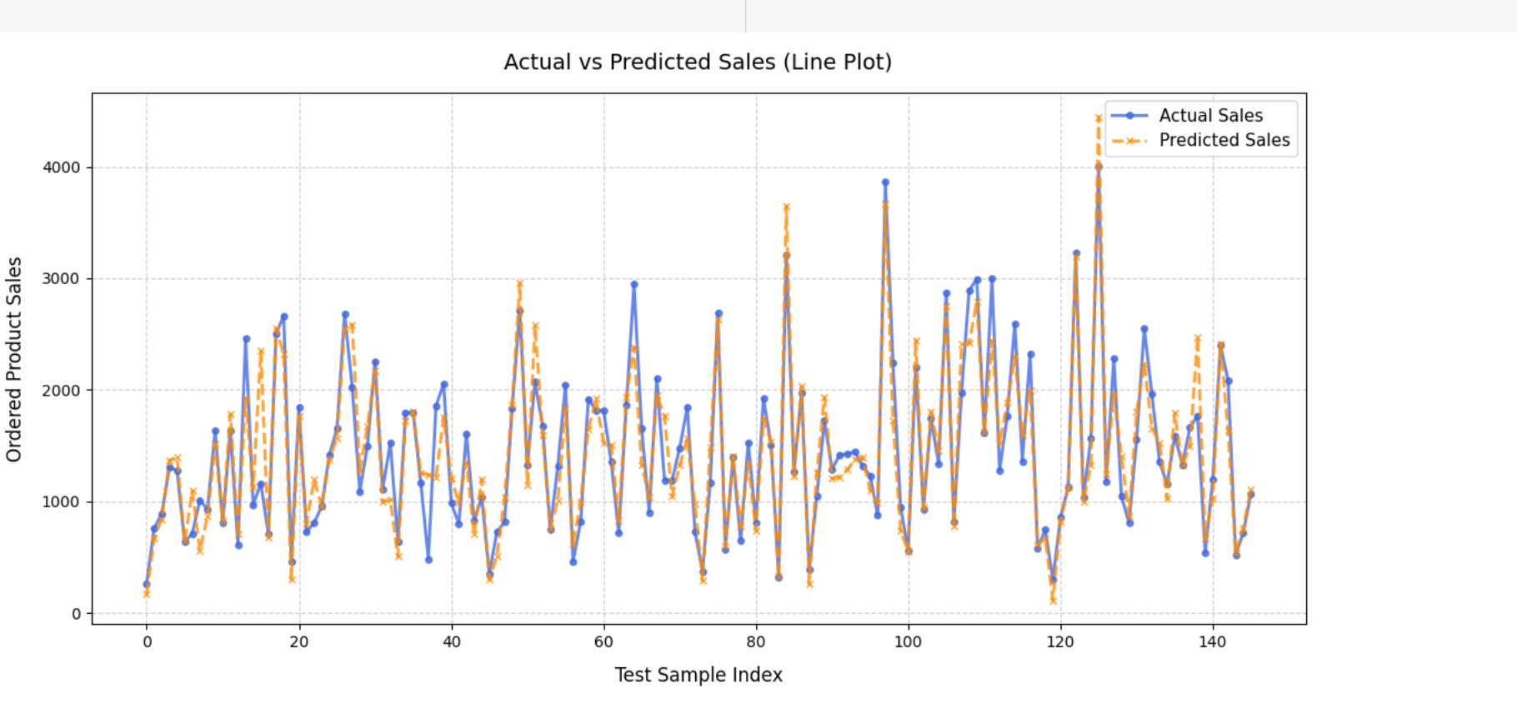
Actual vs Predicted Sales

Slide 17
Challenges Faced
Limited external data (no competitor pricing, promotions).
Only limited amount of features available

Slide 18
Conclusion & Takeaways
Correlation matrix helped identify key drivers of sales.
PyCaret enabled rapid model testing and evaluation.
Huber recommended for future forecasting deployment.

Slide 19
Exploratory Data Analysis (EDA)
Visualized sales trends across time using line plots.
Examined distribution of ad spend and session data.
Detected possible seasonality patterns in traffic and orders.

Slide 20
Why PyCaret for Modeling?
Low-code library to automate model selection and tuning.
Supports multiple algorithms: linear, tree-based, ensemble.
Provides easy comparison of models with built-in metrics.
Saves time while ensuring robust experimentation.

Slide 21

THANK YOU

